Slide 1
Service Delivery Performance and Cost Christiana McFarland Research Director

Slide 2
The National League of Cities is the nation’s oldest and largest organization devoted to strengthening cities and city leadership.
-Resource and advocate for more than 1,600 member cities and the 49 state municipal leagues
-Research, best practices, education and strategies to support local leadership
-Recognizes municipal achievements

Slide 3
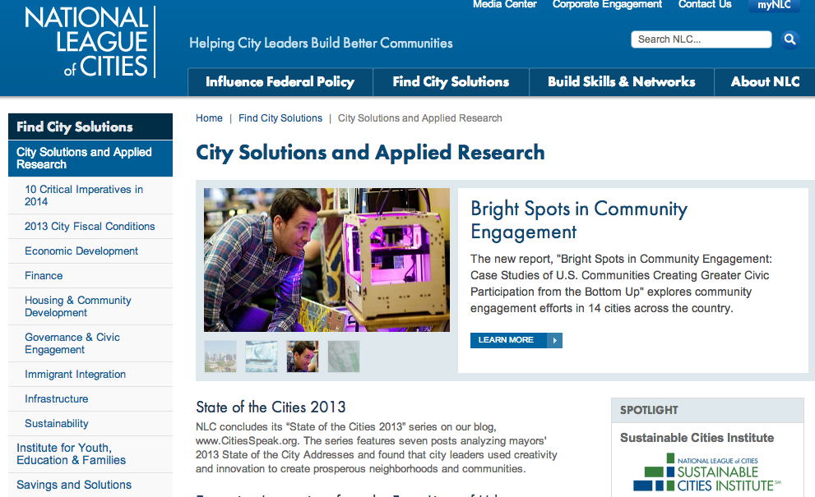
Center for City Solutions and Applied Research
City Solutions and
Applied Research
strengthens the capacity
of municipal leaders to
create strong local
economies, safe and
vibrant neighborhoods,
world-class
infrastructure, and a
sustainable environment.

Slide 4
Fiscal Conditions | Economic
Development | Infrastructure
Housing | Sustainability

Slide 5
Service Delivery Project
Help cities provide more effective and cost-efficient city services
Analyze best practices in performance management and data-driven decision making
Los Angeles, Boston, Dallas, Louisville, Washington DC, Denver, Charlotte, Las Vegas, Kansas City MO, San Antonio, Atlanta, Pittsburgh, St. Paul, Salt Lake City

Slide 6
Services Provided by U.S. Cities
Public Works/Transportation
Public Utilities
Public Safety
Parks & Recreation
Cultural & Arts Programs
Support & Oversight Services

Slide 7
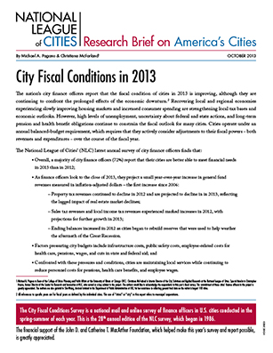
Fiscal Context
Conducted annually since 1986
Survey and review of budget documents from 350 cities
Combination of financial data, fiscal actions, and CFOs perceptions

Slide 8
Fiscal Context

Slide 9
Service Delivery Response
How to create a performance management office
How to collect and analyze data
How to make data-driven decisions
How to measure benefits and outcomes

Slide 10
What We’ve Learned So Far…
Strong leadership
Culture change
Budget
Staff/skills/software
Strategic plan
Open data
Know what to measure
Resident engagement
Systematic review

Slide 11
For More Information
Christiana McFarland
Research Director
202.626.3036
mcfarland@nlc.org
@ckmcfarland
REPORT RELEASE FALL 2014 www.nlc.org

